Slide 1

ARDUINO BASED WEATHER STATION
BE IT
IoE Project
Yashashree Gore (17204009)
Amol Beldar (16104070)
Sanjog Mhasde (15204006)
Under the guidance of
Prof. Kaushiki Upadhaya

Slide 2
Introduction
Weather forecasting is the application of science and technology to predict the state of the atmosphere for a given location. Human beings have attempted to predict the weather informally for millennium and formally since the nineteenth century. Weather forecasts are made by collecting quantitative data about the current state of the atmosphere on a given place and using scientific understanding of atmospheric processes to project how the atmosphere will evolve on that place. Using Internet of Things (IOT), we can control any electronic equipment in homes and industries. Moreover, you can read a data from any sensor and analyse it graphically from anywhere in the world.
Here, we can read temperature and humidity data from DHT11 sensor and upload it to a ThingSpeak cloud using Arduino Uno and ESP8266-02 module. Arduino Uno is MCU, it fetch a data of humidity and temperature from DHT11 sensor and Process it and give it to a ESP8266 Module.ESP8266 is a WiFi module, it is one of the leading platform for Internet of Things. It can transfer a data to IOT cloud.

Slide 3
Problem Statement
To design a weather station using Arduino Uno which shows humdity and temperature on thingspeak screen.

Slide 4
Objective
Using the DHT11 sensor temperature & humidity of environment is detected and this received data will be sent to an android app via ESP8266-02 wifi module.

Slide 5
Application Areas
To ensure the weather quality using arduino system.
To check the quality of weather in the building or residential area which cannot be checked manually from time to time.

Slide 6
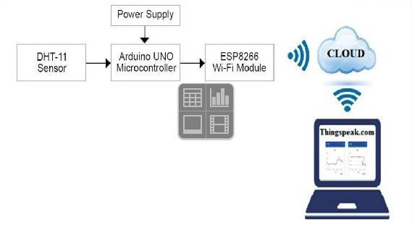
Block Diagram

Slide 7
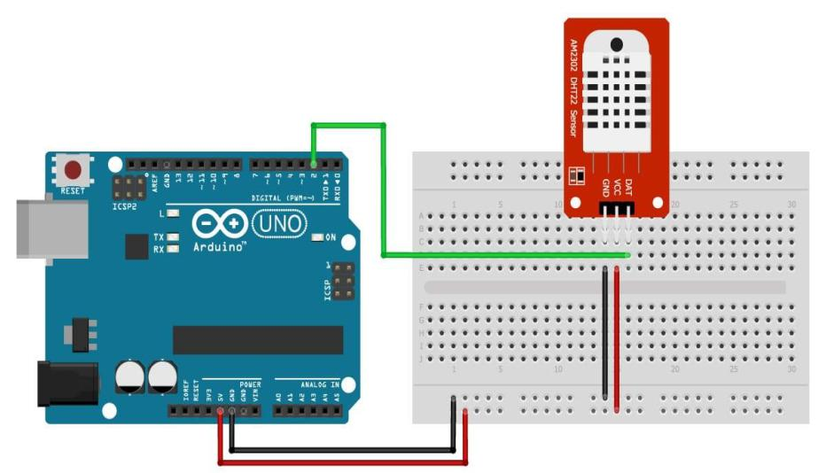
Circuit Diagram

Slide 8
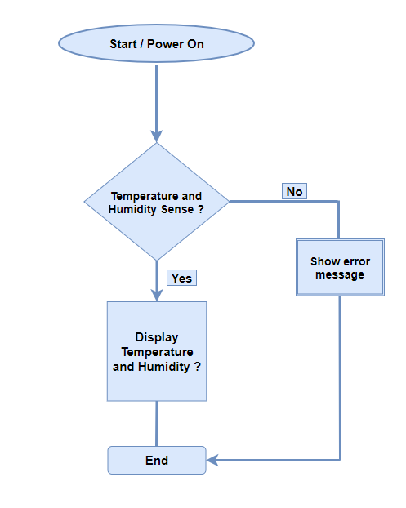
Flowchart

Slide 9
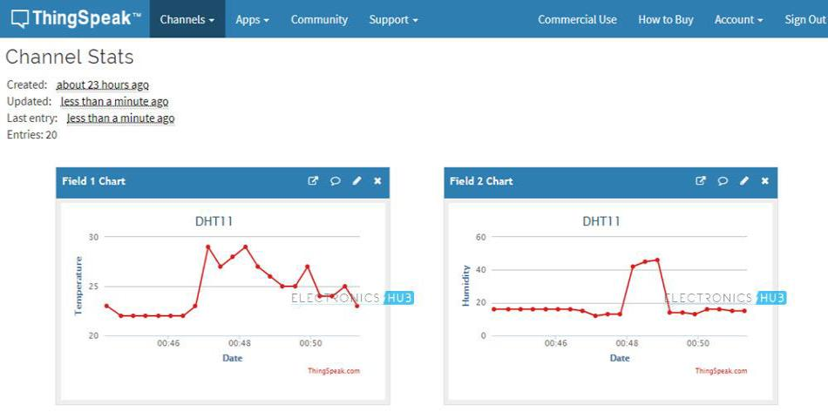
Working
DHT11 Readings

Slide 10
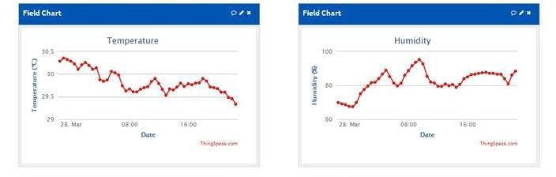
Temperature and Humidity Readings

Slide 11
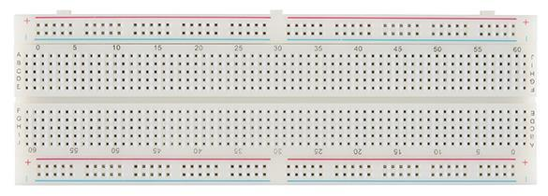
Hardware and Software Requirements
A) Hardware Requirements :-
Breadboard :-

Slide 12
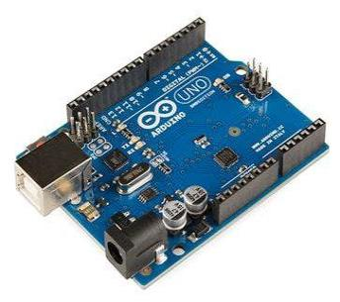
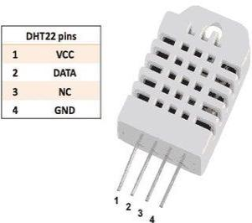
3) Humidity and Temperature Sensor (DHT11) :-
2) Arduino Uno :-

Slide 13

B) Software Requirements :-
Arduino IDE

Slide 14
Conclusion
This concludes that the present work was a success and it will provide a competent method for recording real time weather readings and help farmers whose livelihood depends on the weather in a country like India to produce better quality crops. It can be used to gather information about the requirements for each area over the years. The gathered information is used to determine the optimal conditions for plants to grow and the farmer can modify the environment suitable for the growth of the plant. This, in turn will have a huge impact on agriculture and also on farmers throughout the world. In future, sensors to analyze air quality usinggas detectors could be included and a web interface or service to feed the data directly to Internet could also be built.

Slide 15
References
Satoh. F, Itakura. M, “Cloud-based Infrastructure for Managing and Analyzing Environmental Resources”, SRII Global Conference, pp.325- 334, 201.
Kurschl. W, Beer W, “Combining cloud computing and wireless sensor networks”, International Conference on Information Integration and Web- based Applications and Services, pp.512-518, 2009.
Zhengtong. Y, Wenfeng. Z, “The research ofenvironmental pollution examination system based on the Cloud Computing”, International Conference on Communication Software and Networks, pp.514516, 2011.
Montgomery. K, Chiang. K, “A New Paradigm for Integrated Environmental Monitoring”, ACM International Conference Proceeding Series, 2010.
Wei. Q, Jin. N, Lou X, Ma. R, Xu. J, “Software design for water environment remote monitoring system based on mobile devices”, Applied Mechanics and Materials, pp. 2027-2032, 2011.

